Slide 1
Metadata for
Research Data Management (RDM)
Gail M Thornton
Sharon Farnel
ACCESS 2019 CONFERENCE 2019.09.30

Slide 2
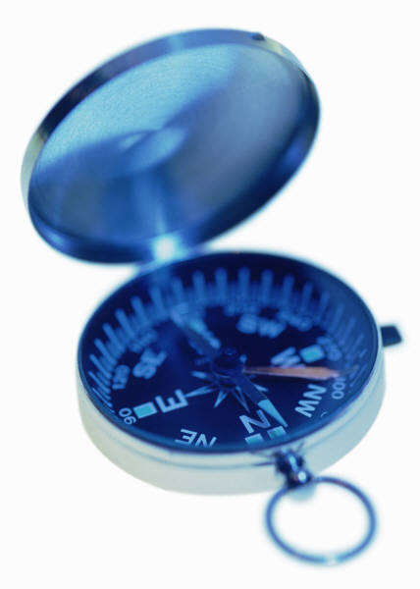
Introduction

Slide 3
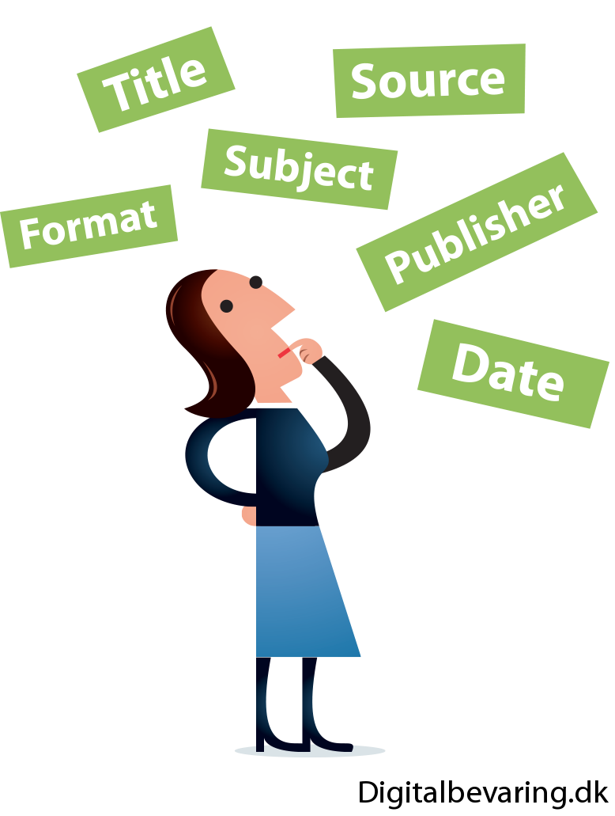
Introduction
Metadata documents and describes data.
Illustrations by Jørgen Stamp from Digitalbevaring.dk
shared under CC BY 2.5 Denmark licence

Slide 4
Introduction
Metadata helps with research data management (RDM).
Illustrations by Jørgen Stamp from Digitalbevaring.dk
shared under CC BY 2.5 Denmark licence

Slide 5
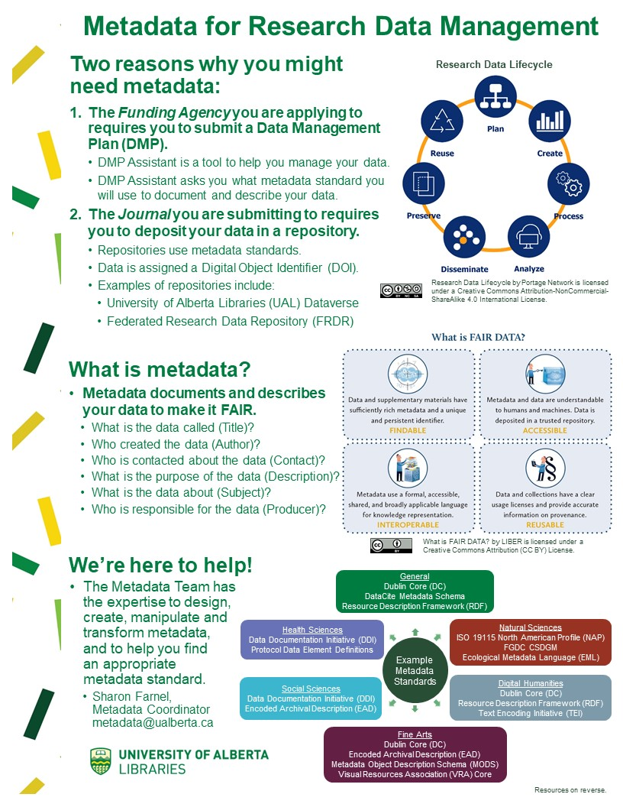
Introduction
The process of preparing a one-pager to promote Metadata Team services to researchers requiring metadata assistance for RDM.

Slide 6
Take Away Message
The development of a one-pager requires all of the rigour of a literature review coupled with the context of instructional design and the willingness to incorporate feedback iteratively to ensure that your message is conveyed in a stand-alone document.
Illustrations by Jørgen Stamp from Digitalbevaring.dk
shared under CC BY 2.5 Denmark licence

Slide 7
Methods

Slide 8
Methods
This exploratory process required review and synthesis of metadata standards with general and discipline-specific applications.
Leahey et al. (2017)
Data Documentation Initiative (DDI) Alliance (2018)
Digital Curation Centre (2019)
The J Paul Getty Trust (2017)
Leahey, A., Barsky, E., Brosz, J., Garnett, A., Gray, V., Hafner, J., … Wilson, L. (2017, September 30). Metadata for Discovery : Disciplinary Standards and Crosswalk Progress Report [R]. doi:http://dx.doi.org/10.14288/1.0355406
Data Documentation Initiative (DDI) Alliance. (2018). Document, Discover and Interoperate. Retrieved from http://www.ddialliance.org/
Digital Curation Centre. (2019). Disciplinary Metadata. Retrieved from http://www.dcc.ac.uk/resources/metadata-standards
The J. Paul Getty Trust. (2017, October 24). Metadata Standards Crosswalk. Retrieved from https://www.getty.edu/research/publications/electronic_publications/intrometadata/crosswalks.html

Slide 9
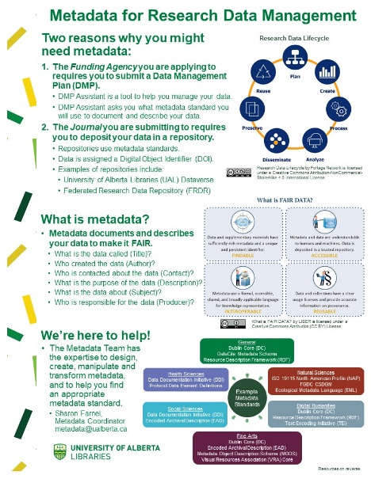
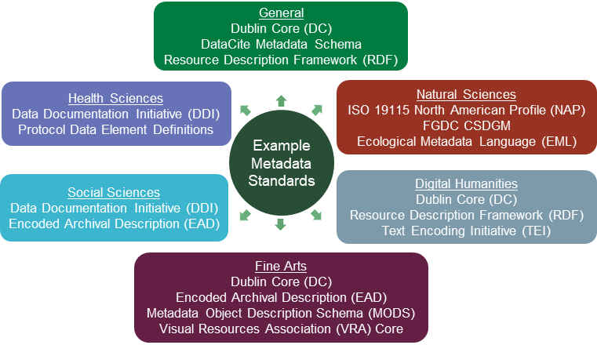

Slide 10
Methods
Requirements of funding agencies, journals and repositories with respect to metadata standards were considered.
Dataverse North Working Group Metadata Subgroup (2019)
Dataverse North Working Group Metadata Subgroup. (2019, April). Dataverse North Metadata Best Practices Guide. Retrieved from https://portagenetwork.ca/wp-content/uploads/2019/04/DVN-Metadata_EN.pdf

Slide 12
Methods
Important concepts were included; for example, research data lifecycle and FAIR (Findable, Accessible, Interoperable, Reusable) Data Principles.
LIBER (Ligue des Bibliothèques Européennes de Recherche – Association of European Research Libraries)
LIBER (Ligue des Bibliothèques Européennes de Recherche – Association of European Research Libraries). (n.d.). Implementing FAIR Data Principles: The Role of Libraries. Retrieved from https://libereurope.eu/wp-content/uploads/2017/12/LIBER-FAIR-Data.pdf

Slide 13
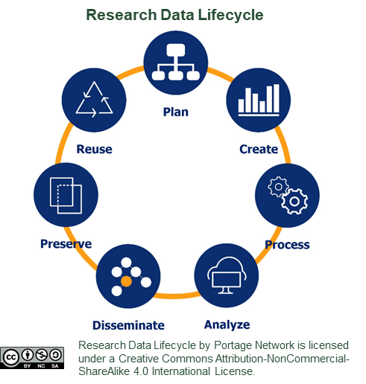

Slide 14
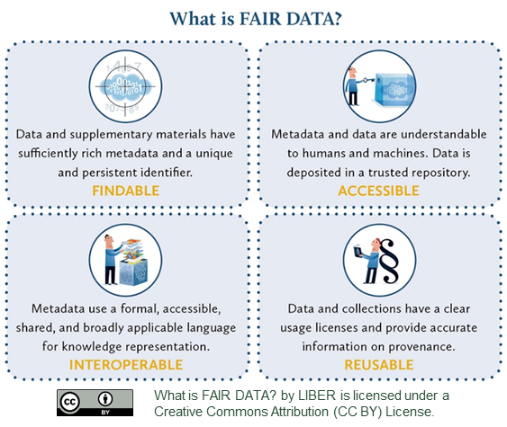

Slide 15
Methods
Tools available to researchers were incorporated including Data Management Plan (DMP) Assistant, Dataverse, and Federated Research Data Repository (FRDR).
Portage Network (2019)
Portage Network. (2019, April). Portage-Supported Repository Options. Retrieved from https://portagenetwork.ca/wp-content/uploads/2019/04/DVNFRDR-Guide.pdf

Slide 18
Results

Slide 19
Results
The one-pager resulted from a collaborative process with members of the Metadata Team.

Slide 20
Results
Metadata standards were summarized graphically for the disciplines addressed in the RDM Therapy Sessions:
Natural Sciences
Digital Humanities
Fine Arts
Social Sciences
Health Sciences

Slide 22
Results
The iterative process revealed the importance of addressing:
why the researchers might need metadata
what is metadata
how the Metadata Team could help

Slide 24
Dataverse North Working Group Metadata Subgroup. (2019, April). Dataverse North Metadata Best Practices Guide. Retrieved from https://portagenetwork.ca/wp-content/uploads/2019/04/DVN-Metadata_EN.pdf

Slide 26
Discussion

Slide 27
Discussion
Illustrations by Jørgen Stamp from Digitalbevaring.dk
shared under CC BY 2.5 Denmark licence

Slide 28
Discussion
Content
Metadata Standards
Metadata Requirements
Important Concepts
Helpful Tools
Context
Relevance
Importance

Slide 29
Take Away Message
The development of a one-pager requires all of the rigour of a literature review coupled with the context of instructional design and the willingness to incorporate feedback iteratively to ensure that your message is conveyed in a stand-alone document.
Illustrations by Jørgen Stamp from Digitalbevaring.dk
shared under CC BY 2.5 Denmark licence

Slide 30
Metadata for
Research Data Management (RDM)
Gail M Thornton
Sharon Farnel
ACCESS 2019 CONFERENCE 2019.09.30

